Slide 1
Welcome to !
Theory Of Automata

Slide 2
Introduction to languages
There are two types of languages
  Formal Languages (Syntactic languages)
  Informal Languages (Semantic languages)

Slide 3
Alphabets
Definition:
A finite non-empty set of symbols (letters), is called an alphabet. It is denoted by Σ ( Greek letter sigma).
Example:
Σ={a,b}
Σ={0,1} //important as this is the language //which the computer understands.
Σ={i,j,k}

Slide 4
NOTE:
A certain version of language ALGOL has 113 letters
Σ (alphabet) includes letters, digits and a variety of operators including sequential operators such as GOTO and IF

Slide 5
Strings
Definition:
Concatenation of finite symbols from the alphabet is called a string.
Example:
If Σ= {a,b} then
a, abab, aaabb, ababababababababab

Slide 6
NOTE:
EMPTY STRING or NULL STRING
Sometimes a string with no symbol at all is used, denoted by (Small Greek letter Lambda) λ or (Capital Greek letter Lambda) Λ, is called an empty string or null string.
The capital lambda will mostly be used to denote the empty string, in further discussion.

Slide 7
Words
Definition:
Words are strings belonging to some language.
Example:
If Σ= {x} then a language L can be defined as
L={x^{n} : n=1,2,3,…..} or L={x,xx,xxx,….}
Here x,xx,… are the words of L

Slide 8
NOTE:
All words are strings, but not all strings are words.

Slide 9
Valid/In-valid alphabets
While defining an alphabet, an alphabet may contain letters consisting of group of symbols for example Σ₁= {B, aB, bab, d}.
Now consider an alphabet
Σ₂= {B, Ba, bab, d} and a string BababB.

Slide 10
This string can be tokenized in two different ways
  (Ba), (bab), (B)
  (B), (abab), (B)
Which shows that the second group cannot be identified as a string, defined over
Σ = {a, b}.

Slide 11
As when this string is scanned by the compiler (Lexical Analyzer), first symbol B is identified as a letter belonging to Σ, while for the second letter the lexical analyzer would not be able to identify, so while defining an alphabet it should be kept in mind that ambiguity should not be created.

Slide 12
Remarks:
While defining an alphabet of letters consisting of more than one symbols, no letter should be started with the letter of the same alphabet i.e. one letter should not be the prefix of another. However, a letter may be ended in the letter of same alphabet i.e. one letter may be the suffix of another.

Slide 13
Conclusion
Σ₁= {B, aB, bab, d}
Σ₂= {B, Ba, bab, d}
Σ₁ is a valid alphabet while Σ₂ is an in-valid alphabet.

Slide 14
Length of Strings
Definition:
The length of string s, denoted by |s|, is the number of letters in the string.
Example:
Σ={a,b}
s=ababa
|s|=5

Slide 15
Example:
Σ= {B, aB, bab, d}
s=BaBbabBd
Tokenizing=(B), (aB), (bab), (d)
|s|=4

Slide 16
Reverse of a String
Definition:
The reverse of a string s denoted by Rev(s) or s^{r}, is obtained by writing the letters of s in reverse order.
Example:
If s=abc is a string defined over Σ={a,b,c}
then Rev(s) or s^{r} = cba

Slide 17
Example:
Σ= {B, aB, bab, d}
s=BaBbabBd
Rev(s)=dBbabaBB

Slide 18




Another Operation
Example:
Definition:

Slide 19



The * Operation
: the set of all possible strings from
alphabet

Slide 20


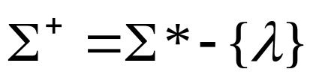
The + Operation
: the set of all possible strings from
alphabet except

Slide 21

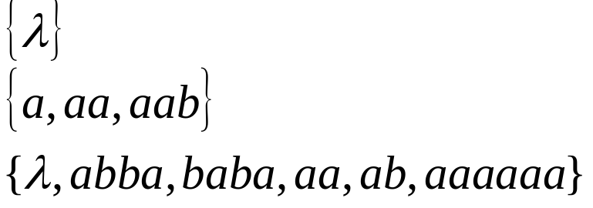
Languages
A language is any subset of
Example:
Languages:

Slide 22




Note that:
Sets
Set size
Set size
String length

Slide 23




Another Example
An infinite language

Slide 24


Operations on Languages
The usual set operations
Complement:

Slide 25



Reverse
Definition:
Examples:

Slide 26


Concatenation
Definition:
Example:

Slide 27



Another Operation
Definition:
Special case:

Slide 28



More Examples

Slide 29


Star-Closure (Kleene *)
Definition:
Example:

Slide 30
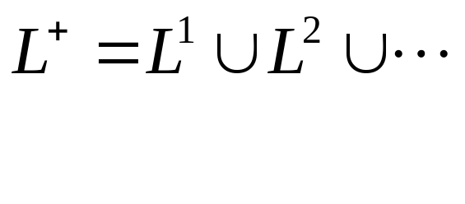

Positive Closure
Definition:

Slide 31
Defining Languages
The languages can be defined in different ways , such as Descriptive definition, Recursive definition, using Regular Expressions(RE) and using Finite Automaton(FA) etc.
Descriptive definition of language:
The language is defined, describing the conditions imposed on its words.

Slide 32
Example:
The language L of strings of odd length, defined over Σ={a}, can be written as
L={a, aaa, aaaaa,…..}
Example:
The language L of strings that does not start with a, defined over Σ={a,b,c}, can be written as
L={b, c, ba, bb, bc, ca, cb, cc, …}

Slide 33
Example:
The language L of strings of length 2, defined over Σ={0,1,2}, can be written as
L={00, 01, 02,10, 11,12,20,21,22}
Example:
The language L of strings ending in 0, defined over Σ ={0,1}, can be written as
L={0,00,10,000,010,100,110,…}

Slide 34
Example: The language EQUAL, of strings with number of a’s equal to number of b’s, defined over Σ={a,b}, can be written as
{Λ ,ab,aabb,abab,baba,abba,…}
Example: The language EVEN-EVEN, of strings with even number of a’s and even number of b’s, defined over Σ={a,b}, can be written as
{Λ, aa, bb, aaaa,aabb,abab, abba, baab, baba, bbaa, bbbb,…}

Slide 35
Example: The language INTEGER, of strings defined over Σ={-,0,1,2,3,4,5,6,7,8,9}, can be written as
INTEGER = {…,-2,-1,0,1,2,…}
Example: The language EVEN, of stings defined over Σ={-,0,1,2,3,4,5,6,7,8,9}, can be written as
EVEN = { …,-4,-2,0,2,4,…}

Slide 36
Example: The language {a^{n}b^{n} }, of strings defined over Σ={a,b}, as
{a^{n} b^{n} : n=1,2,3,…}, can be written as
{ab, aabb, aaabbb,aaaabbbb,…}
Example: The language {a^{n}b^{n}a^{n} }, of strings defined over Σ={a,b}, as
{a^{n} b^{n} a^{n}: n=1,2,3,…}, can be written as
{aba, aabbaa, aaabbbaaa,aaaabbbbaaaa,…}

Slide 37
Example: The language factorial, of strings defined over Σ={1,2,3,4,5,6,7,8,9} i.e.
{1,2,6,24,120,…}
Example: The language FACTORIAL, of strings defined over Σ={a}, as
{a^{n!} : n=1,2,3,…}, can be written as
{a,aa,aaaaaa,…}. It is to be noted that the language FACTORIAL can be defined over any single letter alphabet.

Slide 38
Example: The language DOUBLEFACTORIAL, of strings defined over Σ={a, b}, as
{a^{n!}b^{n!} : n=1,2,3,…}, can be written as
{ab, aabb, aaaaaabbbbbb,…}
Example: The language SQUARE, of strings defined over Σ={a}, as
{a^{n 2} : n=1,2,3,…}, can be written as
{a, aaaa, aaaaaaaaa,…}

Slide 39
Example: The language DOUBLESQUARE, of strings defined over Σ={a,b}, as
{a^{n 2} b^{n 2} : n=1,2,3,…}, can be written as
{ab, aaaabbbb, aaaaaaaaabbbbbbbbb,…}

Slide 40
Example: The language PRIME, of strings defined over Σ={a}, as
{a^{p} : p is prime}, can be written as
{aa,aaa,aaaaa,aaaaaaa,aaaaaaaaaaa…}

Slide 41
An Important language
PALINDROME:
The language consisting of Λ and the strings s defined over Σ such that Rev(s)=s.
It is to be denoted that the words of PALINDROME are called palindromes.
Example:For Σ={a,b},
PALINDROME={Λ , a, b, aa, bb, aaa, aba, bab, bbb, ...}

Slide 42
Remark
There are as many palindromes of length 2n as there are of length 2n-1.
To prove the above remark, the following is to be noted:

Slide 43
Note
Number of strings of length ‘m’ defined over alphabet of ‘n’ letters is n^{m}.
Examples:
  The language of strings of length 2, defined over Σ={a,b} is L={aa, ab, ba, bb} i.e. number of strings = 2²
  The language of strings of length 3, defined over Σ={a,b} is L={aaa, aab, aba, baa, abb, bab, bba, bbb} i.e. number of strings = 2³

Slide 44
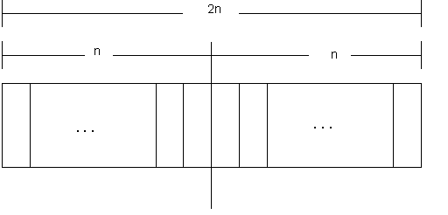
To calculate the number of palindromes of length(2n), consider the following diagram,

Slide 45
which shows that there are as many palindromes of length 2n as there are the strings of length n i.e. the required number of palindromes are 2^{n}.

Slide 46
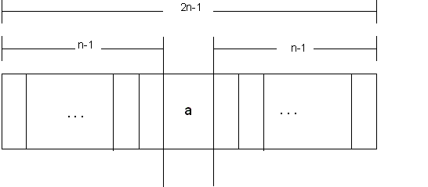
To calculate the number of palindromes of length (2n-1) with ‘a’ as the middle letter, consider the following diagram,

Slide 47
which shows that there are as many palindromes of length 2n-1 as there are the strings of length n-1 i.e. the required number of palindromes are 2^{n-1}.
Similarly the number of palindromes of length 2n-1, with ‘ b ’ as middle letter, will be 2^{n-1} as well. Hence the total number of palindromes of length 2n-1 will be 2^{n-1} + 2^{n-1} = 2 (2^{n-1})= 2^{n} .

Slide 48
Exercise
Q) Prove that there are as many palindromes of length 2n, defined over Σ = {a,b,c}, as there are of length 2n-1. Determine the number of palindromes of length 2n defined over the same alphabet as well.

Slide 49
SummingUp Lecture-1
  Introduction to the course title, Formal and In-formal languages, Alphabets, Strings, Null string, Words, Valid and In-valid alphabets, length of a string, Reverse of a string, Defining languages, Descriptive definition of languages, EQUAL, EVEN-EVEN, INTEGER, EVEN, { a^{n} b^{n}}, { a^{n} b^{n} a^{n} }, factorial, FACTORIAL, DOUBLEFACTORIAL, SQUARE, DOUBLESQUARE, PRIME, PALINDROME.

